Slide 1
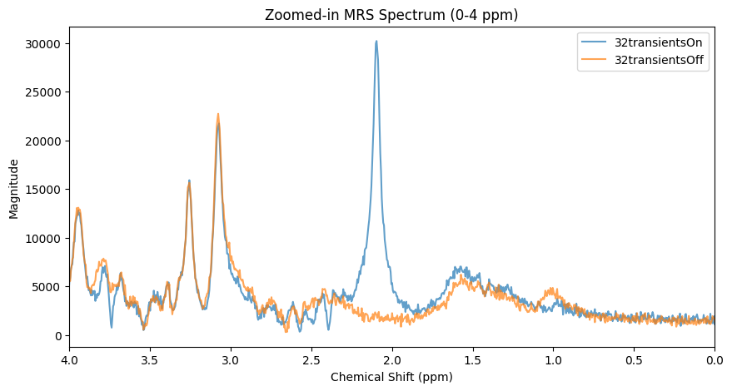
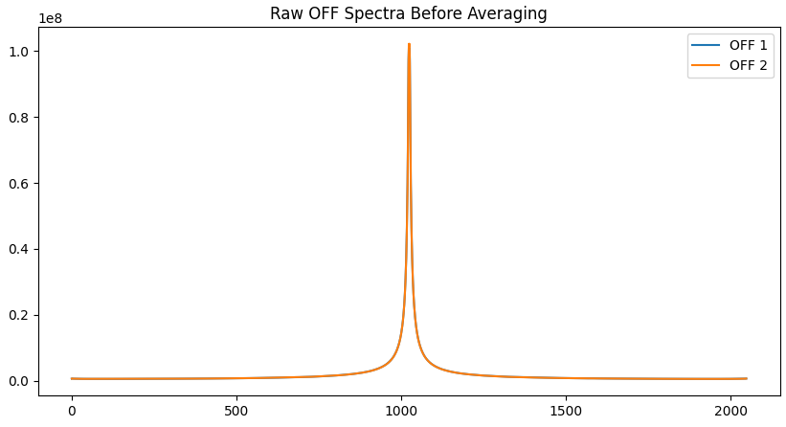
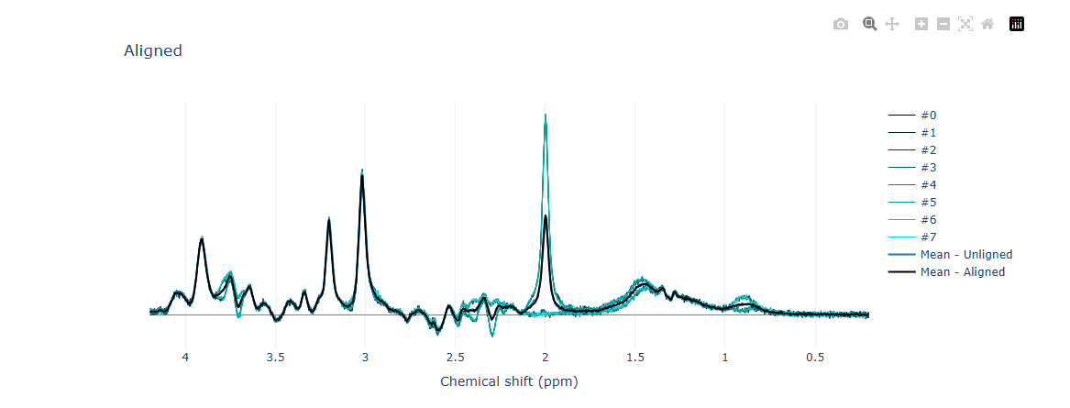
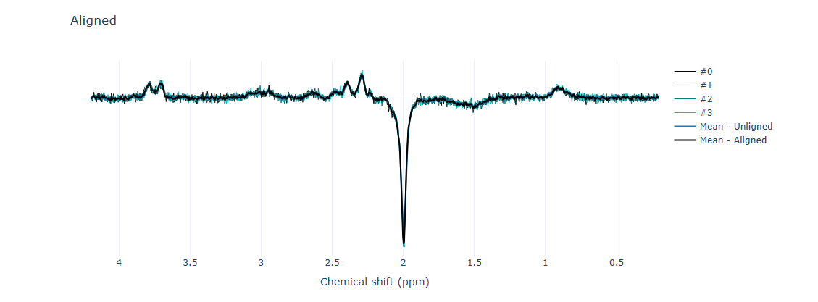
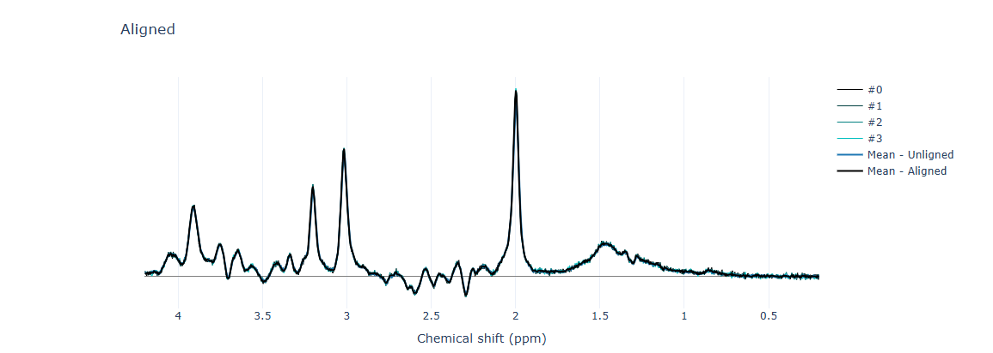
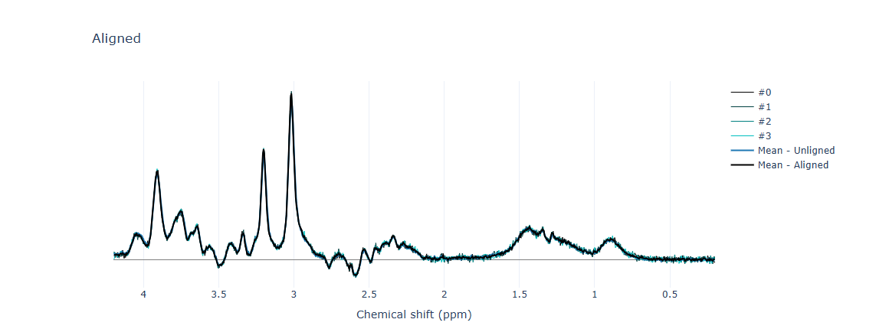
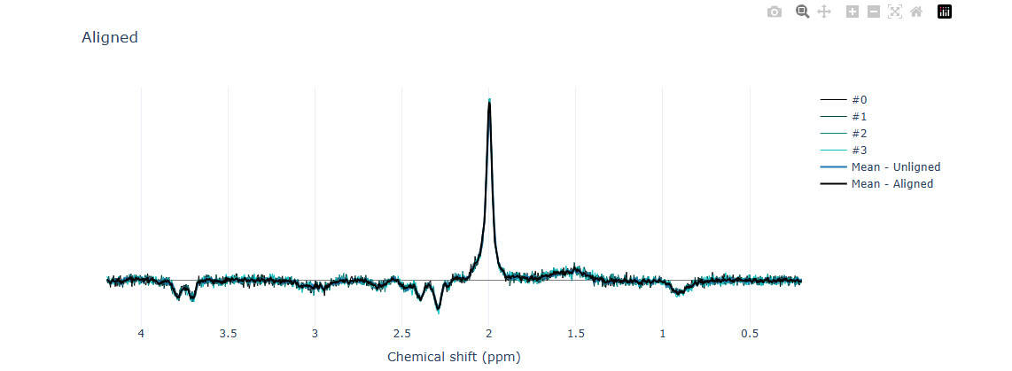
Data structure
Scan parameters
Acquisition: 4 blocks of 64 scans (32 “EDIT OFF” and 32 “EDIT ON”)
VAPOR. Water suppr.
TR 3000 ms
TE 68.00 ms
ON editing pulse = 1.90 ppm
OFF editing pulse = 7.50 ppm
32 On
32 Off
32 On
32 Off
32 On
32 Off
32 On
32 Off
8 Off
64_On_RES
64_On_RES
64_On_RES
64_On_RES
8_On_RES
2_On
2_On
2_On
2_On
2_Off
4On
4Off
4On
4Off
4On
4Off
4On
4Off
Off
Sum
On
Off
On
Off
Diff
Used for all preproc
Fsl_mrs_preproc
Fsl_mrs_preproc
Fsl_mrs_preproc
Fsl_mrs_preproc
or
Fitting
Fitting
Fitting
Fitting
Fitting
QuantificationError: Metabolite reference ['Cr', 'PCr'] has not been fit (conc=0). Please choose another or refine fit first.

